Slide 1

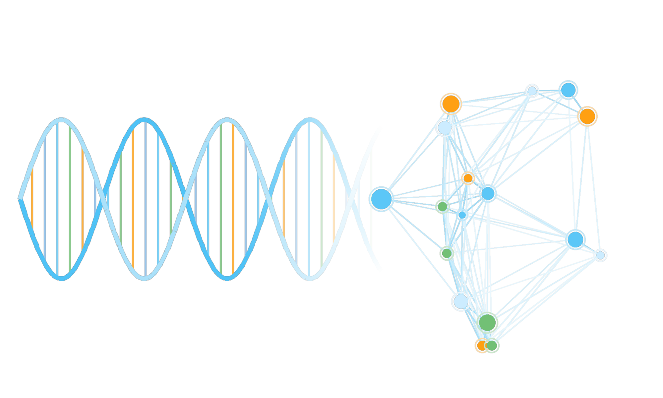
GENETIC ALGORITHMS
Another AI Path
Building Evolutionary Optimization Solutions in C# and .NET
Chris Woodruff
Developer · Architect · Speaker
Notes:
Welcome. Today we explore genetic algorithms — an evolutionary branch of AI — and build up to a working air-freight routing optimizer in C# and .NET.

Slide 2


Slide 3









Chris Woodruff
A quick introduction before we start evolving software.
Developer
Decades of building software across platforms and industries
Architect
Designing systems, services, and data platforms
Speaker
Sharing ideas at conferences and user groups worldwide
woodruff.dev
github.com/cwoodruff
AI and .NET Enthusiast
Exploring the many paths of AI with C# and .NET
/in/chriswoodruff
Notes:
Brief intro — background as developer, architect, speaker. Set up credibility with .NET and AI work. Swap in headshot and correct social links.

Slide 4
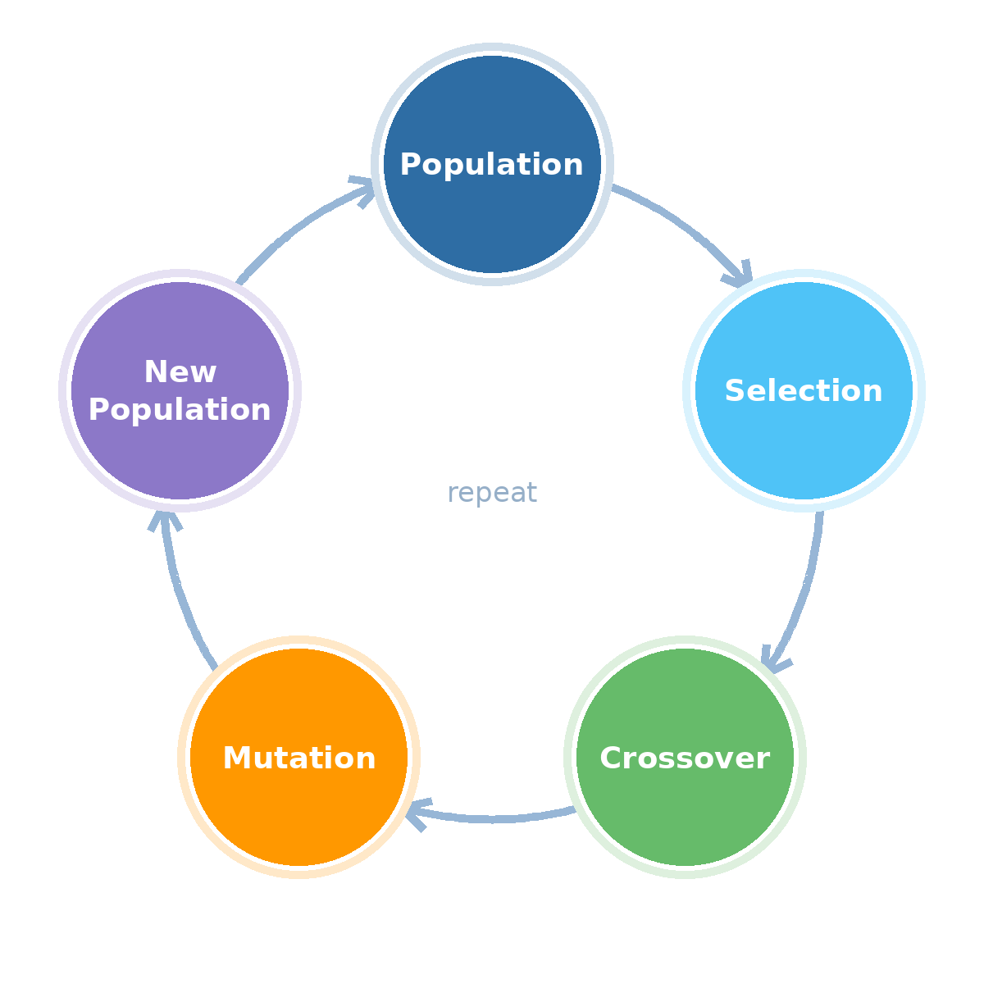
What Is a Genetic Algorithm?
A genetic algorithm is a search technique that finds good solutions to hard problems by evolving them — it breeds a population of candidate answers, keeps the best, combines them, and repeats.
No neural network. No training data. Just a fitness score and the logic of natural selection.
Population
Fitness
Selection
Crossover
Mutation
Five ingredients — every one of them gets its own slide in this talk.
You'll see this loop all talk long.
Notes:
Before I tell you why you'd want one, let me just tell you what it is. One sentence: a GA finds good solutions by evolving them — breed candidates, keep the best, combine, repeat. Everything else in this talk is elaboration on those five chips.

Slide 5
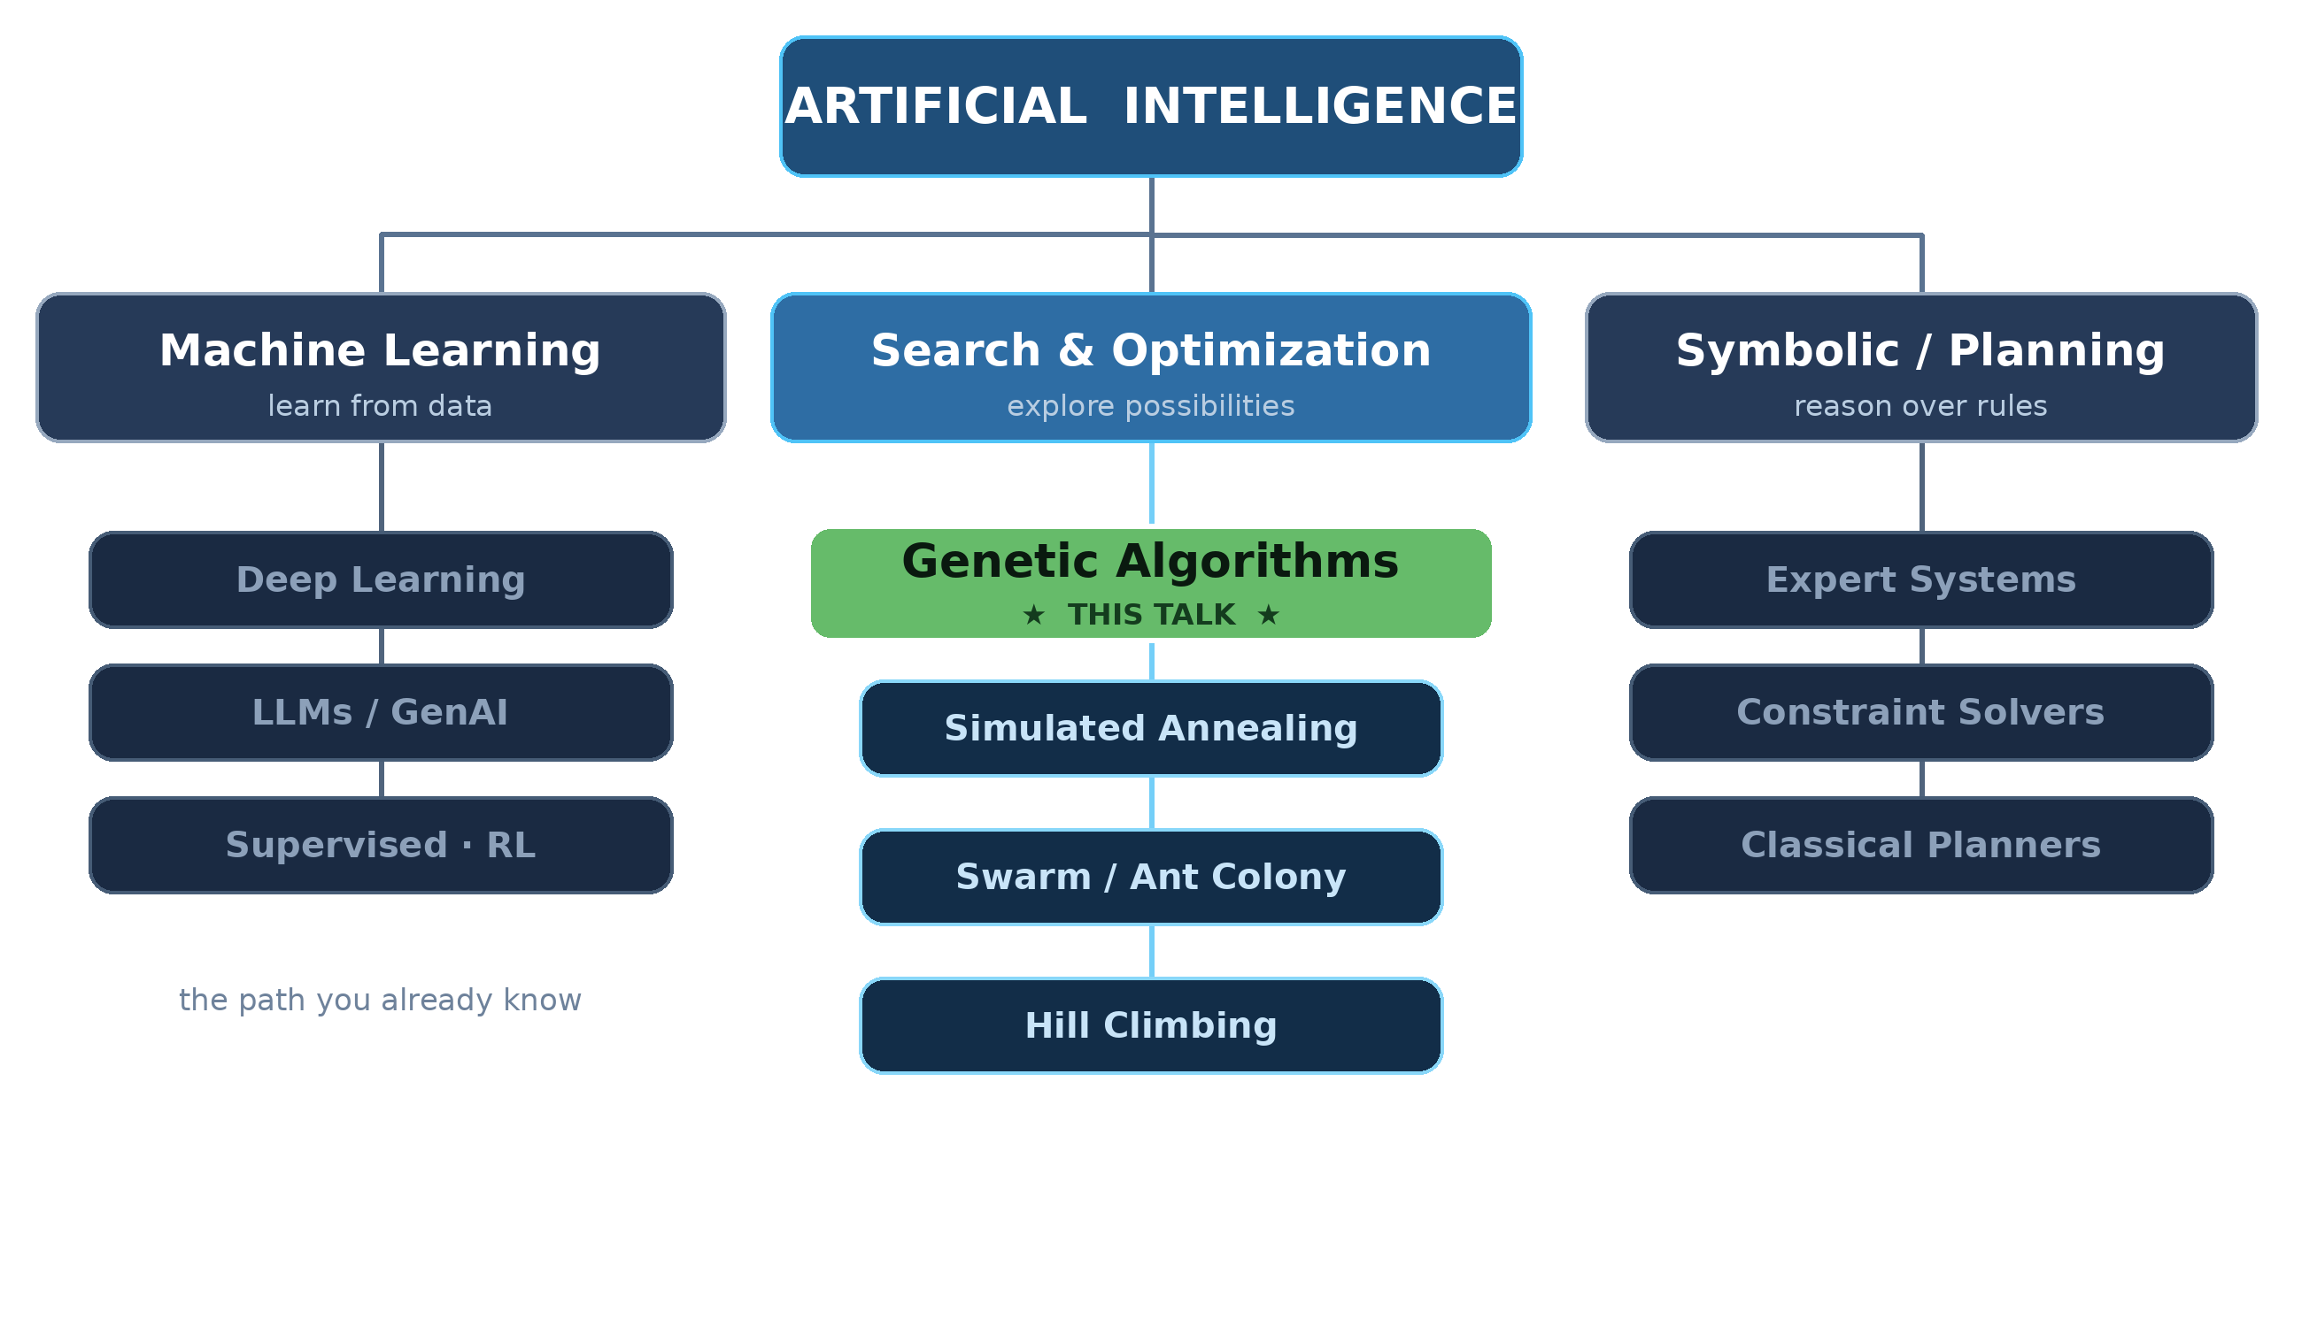
The Map of AI — Another Path
No training data, no gradients, no neural network — a different way to be intelligent: search.
Notes:
When people say AI in 2026 they mean the left branch — deep learning and LLMs. Today we take the middle path: search and optimization. It's older, cheaper, runs on your laptop, and it's surprisingly practical. Genetic algorithms are its most famous resident.

Slide 6


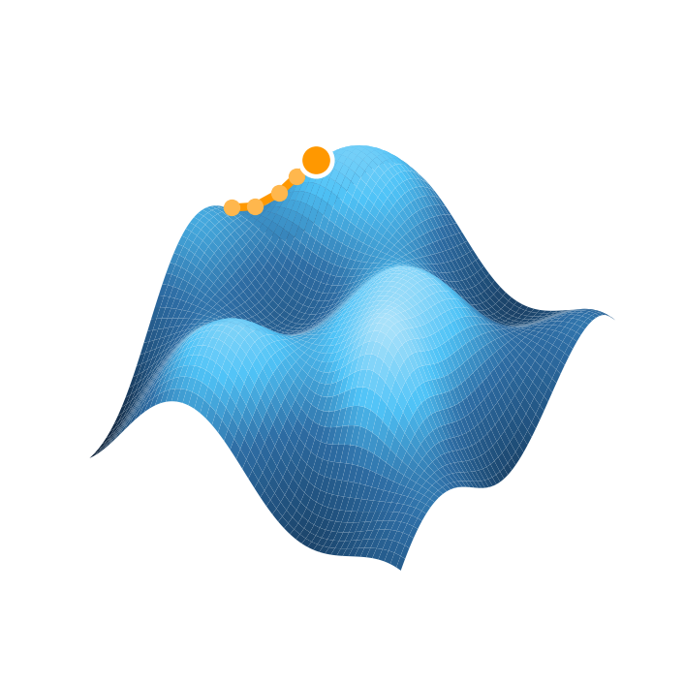
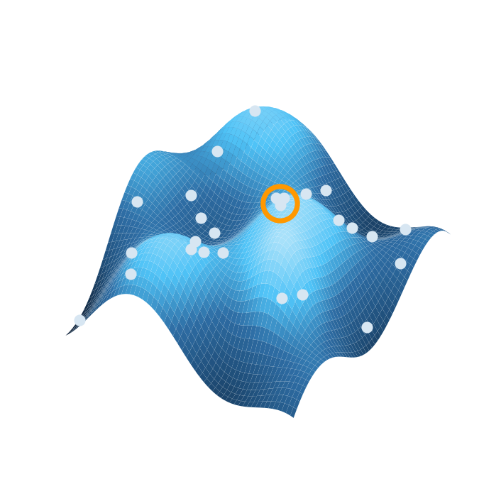
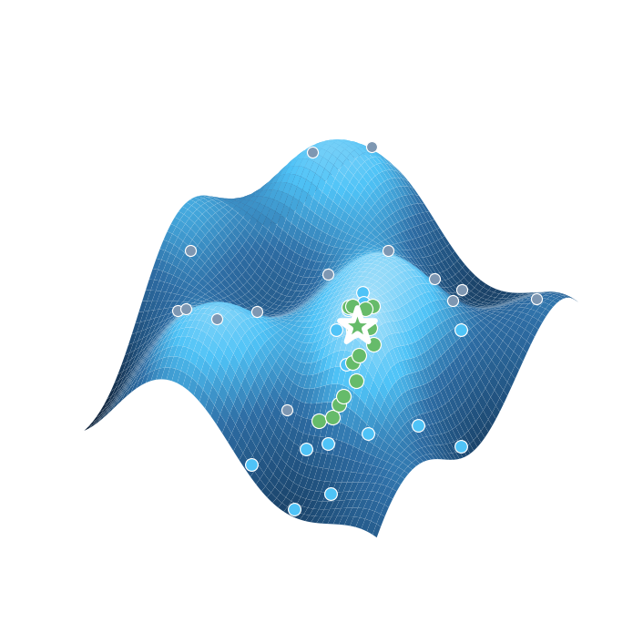
How Do You Find the Best Answer?
Four search strategies, one landscape. Height is solution quality — the goal is the highest peak.
Brute Force
Hill Climbing
Random Search
Genetic Algorithm
Perfect — but explodes at n!
Fast — but trapped on local optima
Escapes traps — but wastes effort
The population learns where to look
gray → blue → green dots = generations 0, 1, 2 of the genetic algorithm converging on the global peak ★
Notes:
There are only a few strategies for searching a huge space — watch each on the same terrain. Brute force checks everything and dies at n factorial. Hill climbing sprints uphill and gets stuck on the first peak. Random search escapes traps but learns nothing. A genetic algorithm is the best of both: a population that concentrates, generation by generation, on the global peak. Remember the n! wall — it comes back in the case study.

Slide 7
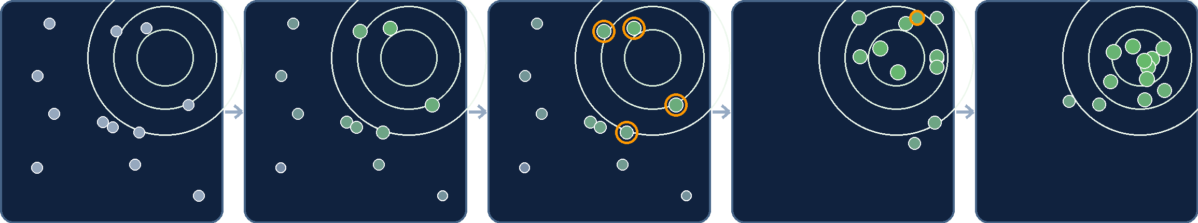
Evolution in Sixty Seconds
One generation, one glance — rings mark the high-fitness zone; greener dots score higher.
1 · Random population
Generation 0 — candidates scattered blindly
2 · Score fitness
Every candidate gets a number
3 · Select parents
Orange rings — the fittest are chosen
4 · Breed offspring
Crossover mixes genes; one mutant appears
5 · Improved population
Generation 1 — clustered near the peak
That's the whole trick: nobody told the dots where the peak was. Selection pressure found it.
Notes:
The whole algorithm in five frames: scatter, score, select, breed, improve. Nobody told the population where the peak was — selection pressure discovered it. Hold this picture; the rest of the talk is just adding engineering detail to it.

Slide 8
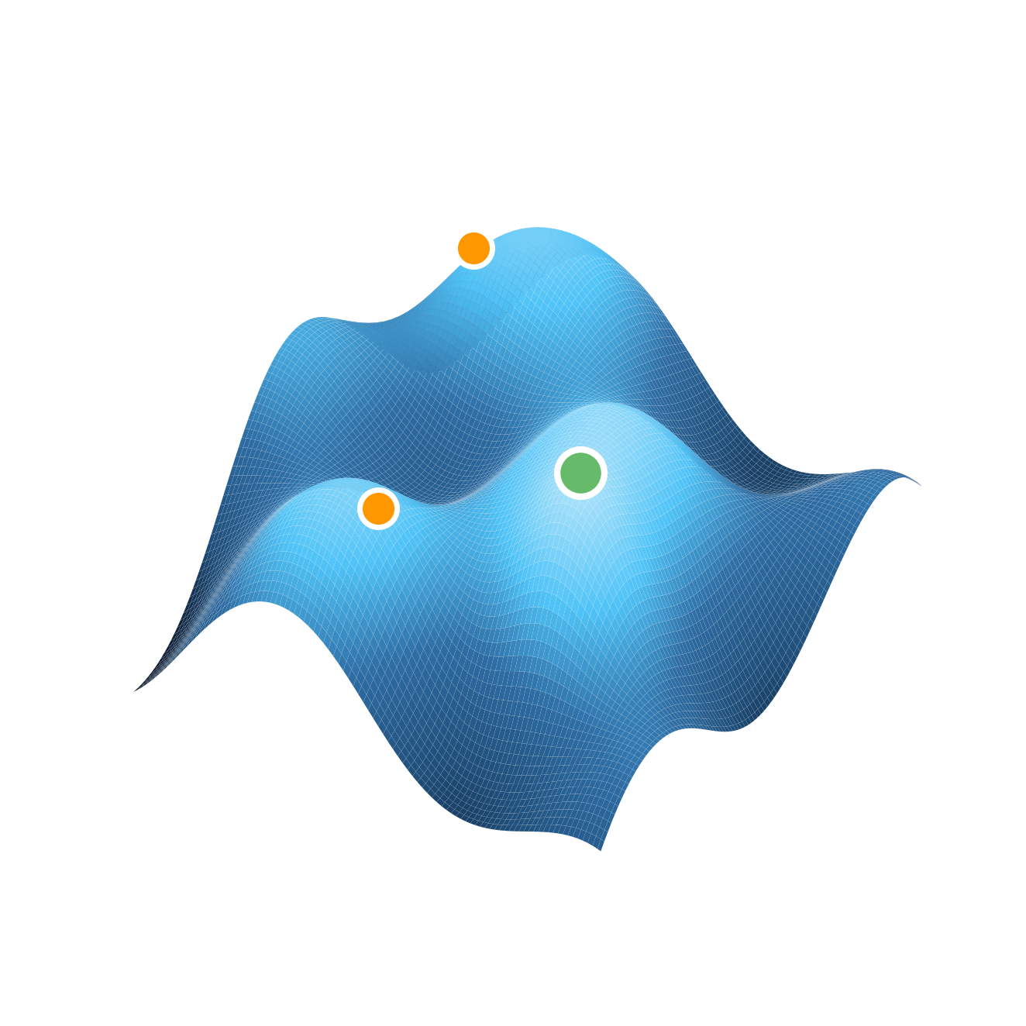




Why Use Genetic Algorithms?
You now know what a genetic algorithm is. Here is why you would want one: real optimization problems have enormous search spaces — far too many possible answers to check.
Routing
Scheduling
Resource Allocation
Planning
Global optimum — the best solution
Local optima — traps for simple search
Notes:
Frame optimization: many candidate solutions, rugged landscape. Hill-climbing gets stuck on local optima; we need a search strategy that explores broadly — evolution.

Slide 9
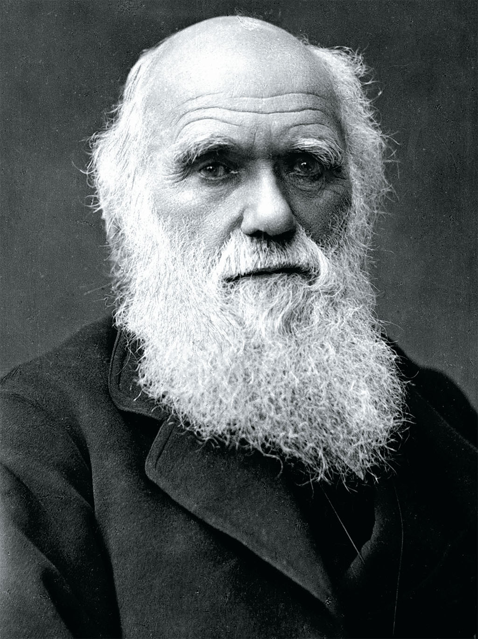
Where Did Genetic Algorithms Come From?
Darwin's theory of evolution inspired genetic algorithms through natural selection and adaptation.
Charles Darwin · 1809–1882 · On the Origin of Species, 1859
1
2
3
4
5
Evolution
Species adapt over generations
Darwin
Natural selection, 1859
Natural Selection
The fittest survive and reproduce
Genetic Algorithms
John Holland, 1975
Modern AI
Optimization engines today
Notes:
Trace the lineage: Darwin's natural selection → Holland formalizes genetic algorithms in 1975 → today they power optimization across industries.

Slide 10



Problems Solved by Genetic Algorithms
FEATURED · NASA ST5 MISSION
An antenna designed by evolution
NASA needed an antenna with a radiation pattern no human engineer had drawn before. A genetic algorithm evolved thousands of candidate shapes — and the strange, bent-wire winner flew to space in 2006.
Large search spaces
Explores shapes humans would never sketch
Creative solutions
No assumptions about what a design should look like
Evolution
Exploration
Optimization
Optimization through evolution
Each generation gets measurably better
NASA ST5 evolved antenna (stylized)
Notes:
The famous NASA ST5 evolved antenna — a design no human would draw, discovered by evolutionary search. Great proof that GAs find creative solutions in huge search spaces.

Slide 11
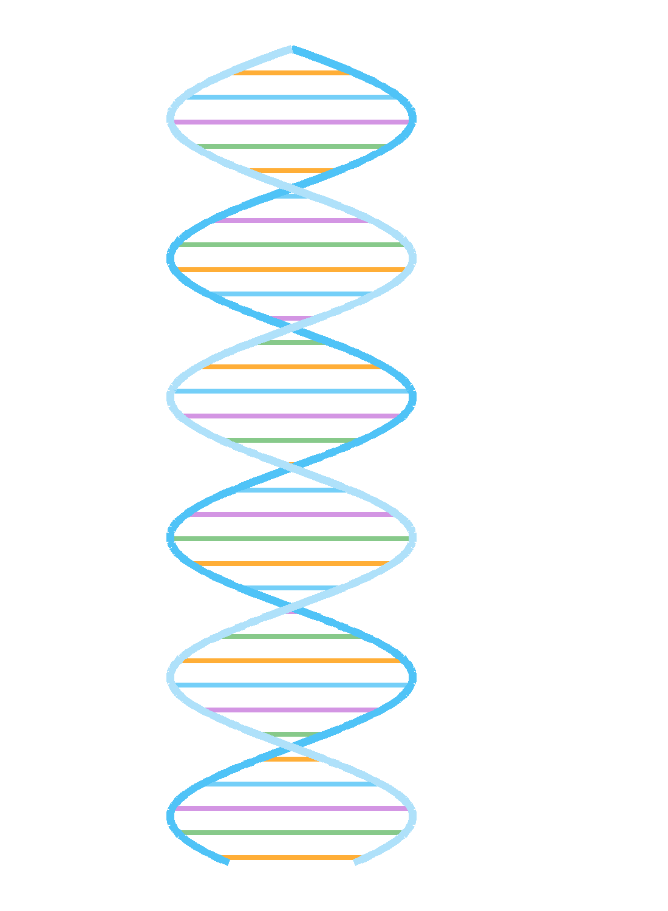
Evolution Overview
The biology that inspired the algorithm — four terms to know.
DNA The molecule that encodes the instructions for building an organism
Gene A single unit of heredity — one instruction in the code
Chromosome A long strand of many genes packaged together
Nucleus The cell's control center, where chromosomes live
Notes:
Quick biology refresher: DNA encodes instructions; genes are single units; chromosomes package genes; the nucleus holds it all. These map directly to GA data structures.

Slide 12
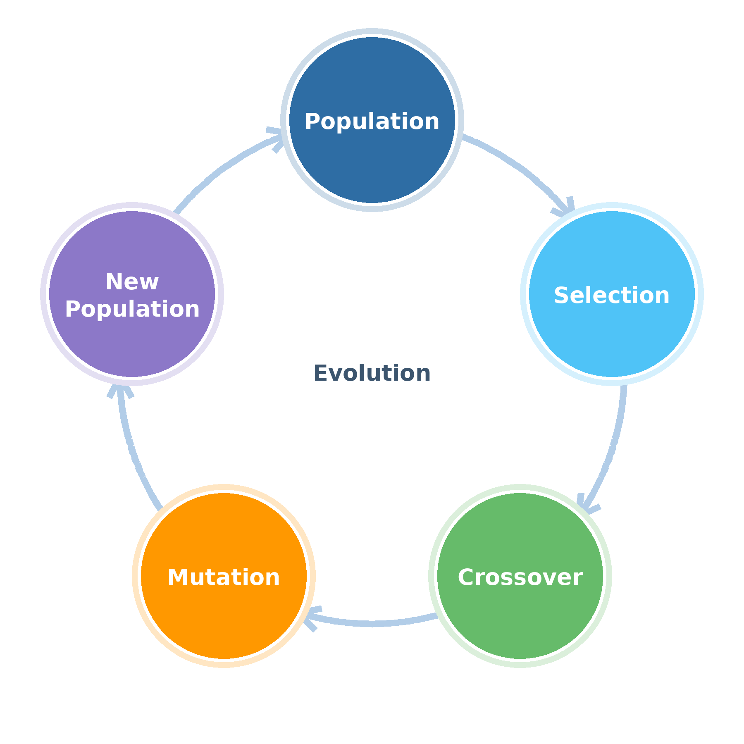
Evolution in Action
One generation at a time, populations improve through four repeating steps.
Population A group of individuals competing to survive
Selection The fittest are chosen to become parents
Crossover Parents combine traits to create offspring
Mutation Random changes introduce fresh variation
Notes:
The core loop of evolution: a population competes, the fittest reproduce, offspring mix traits, mutation adds novelty — and the cycle repeats.

Slide 13
Natural Selection in Three Beats
The classic beetle example — and what each beat becomes once you write it in code.
IN NATURE
1
Variation
2
Selection
3
Heredity
A population of beetles, some green and some orange. No two individuals are identical.
Birds eat what they can see. Orange beetles on green leaves get picked off first.
Survivors breed, colour passes to the next generation, and green spreads.
IN CODE
1
Random Population
2
Fitness Function
3
Crossover & Mutation
Seed generation zero with random candidate solutions scattered across the search space.
Score every candidate. Weak scorers are far less likely to be chosen as parents.
Offspring inherit genes from selected parents, with the occasional random tweak.
Notes:
Optimization shows up in every industry. Any problem with many candidate answers and a scoring function is fair game for evolutionary search.

Slide 14
Genetic Algorithm Terminology
Every biological idea has a direct software counterpart.
BIOLOGY
COMPUTER SCIENCE
Gene
Information Unit
Genome
Solution Structure
Population
Candidate Solutions
Selection
Parent Selection
Crossover
Recombination
Mutation
Random Variation
Notes:
Rosetta stone slide: gene = information unit, genome = solution structure, population = candidate solutions, and so on. Keep referring back to this mapping. Callback: these are the same five chips from the opening definition slide — as promised.

Slide 15
The Genetic Algorithm Lifecycle
Create Population
Random candidate solutions
Evaluate Fitness
Score every individual
Selection
Choose the best parents
REPEAT
Crossover
Combine parent genes
until converged
Mutation
Inject random variation
New Generation
Replace the population
Notes:
THE key diagram of the talk. Walk each stage slowly: create, evaluate, select, cross over, mutate, replace — and loop until the population converges on a strong solution. Callback: this is the little ring from the opening slide, now full size.

Slide 16
Quickly Get To Results
Evolutionary search converges on strong solutions far faster than random search.
Faster convergence
Fitness climbs steeply in early generations
Better results
Ends far above random exploration
Notes:
Selection pressure focuses the search where fitness is high — that is why the green curve races ahead of random sampling and plateaus at a much better solution.

Slide 17
The Fitness Function
Evaluate: one number per candidate — how evolution tells better from worse.
A fitness function takes a candidate solution and returns a single score. It is the only signal evolution ever gets — selection, crossover, and mutation never look at the problem itself.
Route A
Route B
Route C
Fitness Function ƒ(x)
// AirFreightRouter — score one route
double Fitness(Route route) =>
1.0 / (route.FuelCost
+ route.HandlingFees
+ LatePenalty(route)
+ CurfewViolations(route) * 1_000);
92
71
33
Every generation, every candidate, one score — evaluated thousands of times per run.
Lower cost → higher fitness. Hard constraints become heavy penalties.
The score IS the goal: evolution optimizes exactly what you measure — nothing else. Design it with care.
Notes:
Fitness is the missing fifth chip's own slide: one number per candidate, and it's the only signal evolution receives. Walk the pipeline right: routes go in, scores come out, and selection acts purely on those scores. The C# shows the pattern — invert cost, turn hard constraints into heavy penalties. Foreshadow Limitations: a flawed fitness function evolves the wrong thing beautifully.

Slide 18
Selection
Selecting candidate solutions for reproduction — the fittest earn the right to become parents.
Candidate A
fitness 92
Top performers
move forward
Candidate B
fitness 85
They become the parents of the next generation; weak candidates fade out of the gene pool.
Candidate C
fitness 71
Candidate D
fitness 54
Candidate E
fitness 33
Notes:
Rank the population by fitness. The strongest candidates are chosen as parents. Selection is the engine of improvement — without it, evolution is just random drift.

Slide 19

Roulette Selection
Fitness-proportionate selection — spin the wheel, and better solutions own bigger slices.
Every candidate gets a slice
Slice size is proportional to fitness score
1
The wheel is spun for each parent
Selection is random — but weighted
2
Strong candidates win more often
Yet weak ones still get a small chance, preserving diversity
3
Notes:
Roulette selection: each candidate's share of the wheel equals its share of total fitness. High fitness wins more spins, but low-fitness candidates keep a chance — that diversity matters.

Slide 20
Crossover
Two parents combine their genes to produce a child that inherits from both.
Parent A
1
2
3
4
5
6
+
Parent B
1
2
3
4
5
6
crossover point
Child
1
2
3
4
5
6
genes 1–3 from Parent A
genes 4–6 from Parent B
Like DNA recombination, crossover lets good building blocks from two strong parents meet in one offspring.
Notes:
Single-point crossover: pick a cut point, take the head from parent A and the tail from parent B. Good partial solutions — building blocks — combine into better children.

Slide 21
Mutation
A small random change keeps the population exploring new territory.
Before Mutation
After Mutation
A
T
G
C
A
T
A
T
G
G′
A
T
one gene randomly altered
Why mutate? Without mutation, the population can stagnate on one family of solutions. A low mutation rate injects just enough novelty to escape local optima.
Notes:
Mutation flips a single gene at random. Rate matters: too little and the search stagnates, too much and it degenerates into random search. Highlight the orange gene.

Slide 22
Warm-Up: A Genetic Algorithm in 60 Seconds
A problem small enough to check by hand, so you can watch the machinery work before we scale it up.
1
The Problem
2
Encode
3
Seed
Maximise f(x) = 120x - x² over 0 ≤ x ≤ 127. Calculus gives x = 60, so we already know the right answer.
Represent x as seven bits: 1 is 0000001, 127 is 1111111. That bitstring is the chromosome.
Generate a random starting population of bitstrings scattered across the full 0-127 range.
4
Score
5
Breed
6
Converge
Fitness is just f(x). Decode each chromosome, evaluate, and rank the population.
Crossover at 0.7 and mutation at 0.001. Swap bit segments between parents, flip the occasional bit.
Within a handful of generations, the population piles up on 0111100 - which is 60.
Notes:
Optimization shows up in every industry. Any problem with many candidate answers and a scoring function is fair game for evolutionary search.

Slide 23
What Genetic Algorithms Are Good At
Before we talk about where they fall down, here is why you would reach for one in the first place.
1
No Gradient Required
2
Good Answers Early
3
A Set, Not a Single Answer
Your fitness function can be a black box, a simulation, or a legacy cost engine. It never has to be differentiable.
You get a usable solution in the first few generations and a better one the longer you let it run.
The final population holds several distinct near-optimal options a human can choose between.
4
Embarrassingly Parallel
5
Escapes Local Optima
6
Cheap to Retrofit
Fitness evaluation is independent per individual - fan it out across cores, tasks, or machines.
Mutation plus a diverse population keeps the search from getting stuck the way hill-climbing does.
If you already compute a cost, you already have most of a GA. Encoding and operators are the rest.
Notes:
Optimization shows up in every industry. Any problem with many candidate answers and a scoring function is fair game for evolutionary search.

Slide 24



Limitations
Powerful — but every design choice is a tradeoff.
Fitness Function Design
The score IS the goal — a flawed fitness function evolves the wrong thing
TRADEOFFS
Computational Cost
Convergence Challenges
Thousands of evaluations per run; fitness must be fast or parallel
Populations can converge early on mediocre solutions and stop improving
Notes:
Be honest about limits: fitness design is the hard intellectual work, evaluation cost dominates runtime, and premature convergence is the classic failure mode. Every knob is a tradeoff.

Slide 25
Six Questions to Answer Before You Write Any Code
Every answer depends on the problem in front of you. Decide them deliberately, not by accident.
?
What Encoding?
?
What Fitness Function?
?
Which Selection?
Binary, permutation, or real-valued? The choice constrains which crossover and mutation operators are even legal.
Usually, the inverse of a cost you already compute. Get it wrong, and the GA will optimize the wrong thing beautifully.
Roulette, rank, tournament, or elitism? Pick for the shape of your fitness distribution, not out of habit.
?
Which Operators?
?
When Does It Stop?
?
How Will You Know?
Single-point, two-point, or uniform crossover. Bit-flip or swap mutation? They must match the encoding.
Iteration cap, target fitness, or no improvement for N generations? Decide before you press run.
Choose your baseline up front. Without one, “the GA found something” is not a result.
Notes:
Optimization shows up in every industry. Any problem with many candidate answers and a scoring function is fair game for evolutionary search.

Slide 26
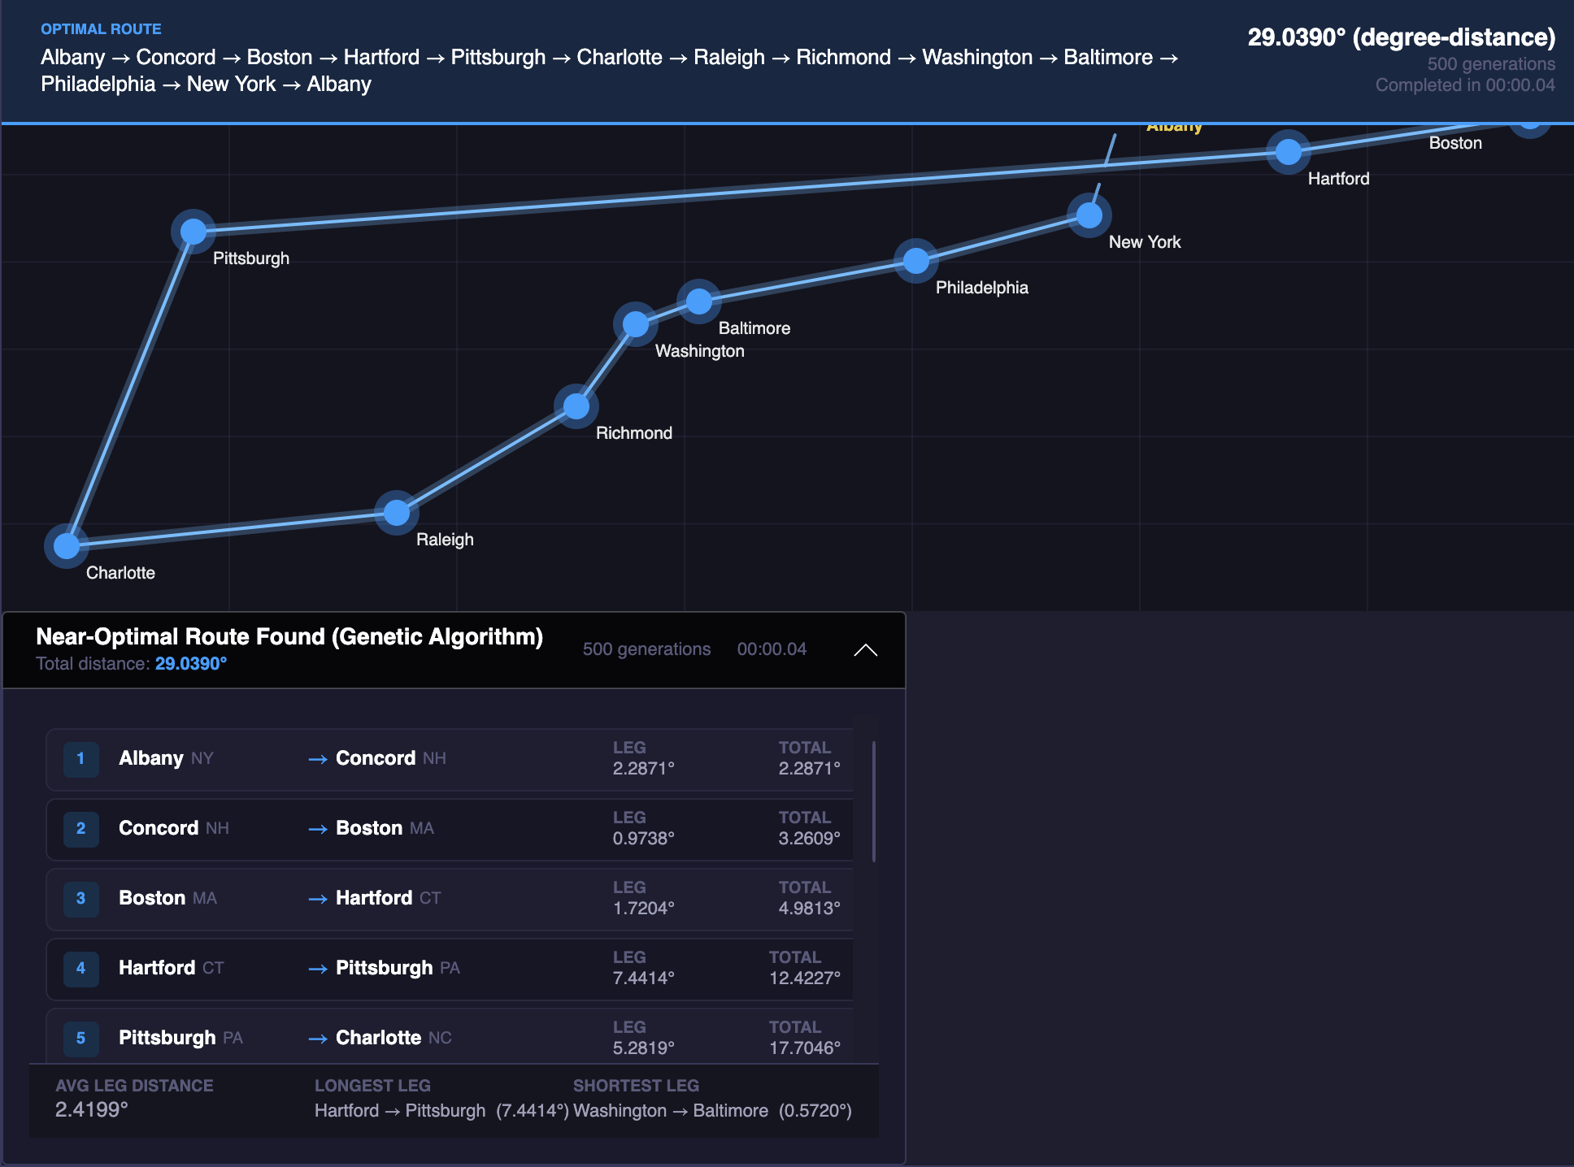




CASE STUDY
Air Freight Route Optimization
AirFreightRouter — a C# / .NET genetic algorithm that evolves cargo routes across a global airport network.
Cost
Time
Minimize fuel, fees, and handling
Meet delivery windows
Efficiency
Constraints
Maximize load and utilization
Capacity, customs, curfews
github.com/cwoodruff/AirFreightRouter
Notes:
Introduce the case study: real-world cargo routing with competing goals — cost, time, efficiency — under hard constraints. The green path is one evolved solution.

Slide 27
Mapping Genetics to Routing
The same terminology table — now wearing an air-freight uniform.
GENETIC ALGORITHM
ROUTING EQUIVALENT
Gene
Airport
Chromosome
Route
Population
Candidate Routes
Fitness Function
Route Score
Selection
Best Routes Survive
Mutation
Route Variation
Notes:
This is where theory becomes software: airports are genes, a route is a chromosome, the route score is the fitness function. Once the mapping clicks, the code writes itself.

Slide 28
AirFreightRouter Results
Best route fitness improves steadily across 50 generations.
+120%
fitness gain, generation 1 → 50
~30
generations to near-optimal routes
0
manual routing rules written
Notes:
Classic GA fitness curve: steep early gains as selection exploits easy wins, then a long refinement tail. Around generation 30 the routes are already near-optimal.

Slide 29
AirFreightRouter Architecture
Airport Network
Graph of airports, distances, and constraints
Route Generator
Builds the initial random population
Built with
C# 14
Fitness Evaluation
Scores cost, time, and constraint violations
.NET 10
Selection Engine
Roulette selection of parent routes
Avalonia
Crossover Engine
Splices parent routes at shared airports
xUnit
Mutation Engine
Swaps or reorders airports in a route
Best Route
Fittest chromosome after N generations
Notes:
Each GA concept becomes a component with a single responsibility — easy to unit test and easy to swap strategies. Walk the data flow from network graph to best route.

Slide 30
Tuning the Knobs
Say these numbers out loud when you show results. Without them, nobody can reproduce what you just demonstrated.
1
Population Size
2
Generation Cap
3
Selection Method
How many candidates per generation. Bigger means more diversity and more compute. Typical: 50 to 1,000.
The hard ceiling on iterations, and your worst-case runtime. Typical: 100 to 5,000.
Roulette, rank, or k-way tournament. Tournament with k = 2 or 3 is the common default.
4
Crossover Rate
5
Mutation Rate
6
Elitism Count
How two parents actually recombine. Typical: 0.6 to 0.9.
How often a gene is randomly altered. Kept deliberately low.
How many top performers survive untouched into the next generation? Usually, 1 or 2.
Ranges are common starting points from the literature - replace each with the value AirFreightRouter actually ships with before you present.
Notes:
Optimization shows up in every industry. Any problem with many candidate answers and a scoring function is fair game for evolutionary search.

Slide 31
LIVE DEMO
AirFreightRouter
Application screenshot — replace during rehearsal
Watch for:
Population
Fitness
Selection
Mutation
Notes:
Switch to the running app. Narrate the four things on screen: the population forming, fitness scores climbing, selection pruning weak routes, and occasional mutations shaking things up.

Slide 32
What Just Happened?
Everything in the demo maps straight back to the lifecycle we started with.
Population
Fitness
Selection
Crossover
Mutation
Optimization
Random routes created
Each route scored
Best routes chosen
Routes recombined
Airports swapped
Champion route emerged
The takeaway: no routing rules were ever written. We only defined what a good route looks like — evolution discovered how to build one.
Notes:
Close the loop: reconnect every demo moment to the lifecycle diagram. Emphasize that we specified the WHAT (fitness), and evolution found the HOW.

Slide 33

Books and Resources
Where to go deeper — the classics, plus code you can run tonight.
Projects & Code
GeneticSharp
Mature open-source GA library for .NET
Genetic Algorithms in Search, Optimization & Machine Learning
An Introduction to Genetic Algorithms
Practical Genetic Algorithms
AirFreightRouter
Today's demo — clone it and experiment
Sample GA repositories
Curated examples, from TSP to scheduling
David E. Goldberg
Melanie Mitchell
Randy & Sue Ellen Haupt
QR → repo links
The classics — theory, intuition, and practice
https://woodruff.dev/evolve-your-c-code-with-ai-a-5-week-genetic-algorithms-bootcamp-for-developers/
Notes:
Goldberg for theory, Mitchell for intuition, Haupt for practice. GeneticSharp if you want a library; AirFreightRouter if you want to read a from-scratch implementation. Swap in real QR codes.

Slide 34

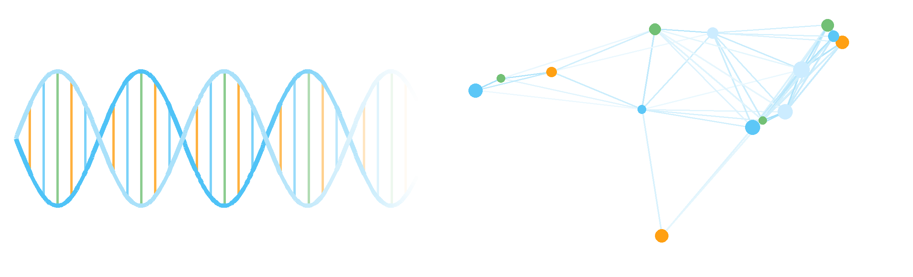


Questions?
Thank you
woodruff.dev
github.com/cwoodruff
chris@woodruff.dev
Slides & code
EVOLVE BETTER SOLUTIONS
Notes:
End with the mantra: evolve better solutions. Point to the QR for slides and code. Take questions.

